Slide 1

Basic Ford-Fulkerson Method (rephrased)
Start with flow = 0 on all links.
Until you’ve reached the value of the min cut:
Choose a path from s to t, and increase flow along the edges of this path as much as possible. To do this, find a path from s to t (u₀=s, u₁, u₂, …, u_{n-1}, u_{n}=t) such that either:
(u_{k}, u_{k+1}) is in the network but not at full capacity, or
(u_{k+1}, u_{k}) [the reverse edge] is in the network with some flow
This implies the possibility of backflow.

Slide 2
Basic F-F Method Analysis
Depends on how to implement the loop.
First, scale the capacities so they are integers with maximum flow |f*|
Then you will do the loop at most |f*| times
Not exactly possible for irrational flows (unlikely in practice)
Create an auxiliary graph G’ = (V,E’) where
E’ = { (u,v): (u,v)∈E or (v,u)∈E}
Allow for backflow.
Edges in residual network is set of all edges in G’ with c_{f}(u,v) > 0
Using DFS or BFS, can find augmenting path in time O(V+E’) = O(E)
Algorithm takes time O(E|f*|)
Ford-Fulkerson Method
---------------------
initialize f = 0
Compute residual network G_{f}
while (∃ augmenting path p in G_{f})
augment flow f along p
recompute G_{f}
return f

Slide 3
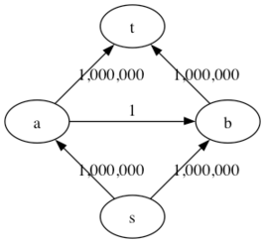
Problem with Basic F-F Method
Can go very slowly if you make poor choices.

Slide 4
Solution: Edmonds-Karp Algorithm
Do the basic Ford-Fulkerson Algorithm, but at each point choose the augmenting path as the path with the fewest number of edges from s to t.
Shortest path when each edge has unit weight
Use Dijkstra’s Lowest-cost-first-search algorithm to find it

Slide 5
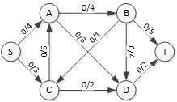
Edmonds-Karp 1

Slide 6
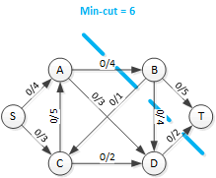
Edmonds-Karp 2
The minimum cut has capacity 6, so when we reach a flow of 6 we can stop.

Slide 7
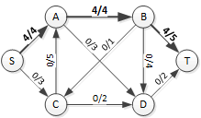
Edmonds-Karp 3
Find the shortest path and augment it
Least number of edges
3 choices here (SABT, SADT, SCDT)

Slide 8
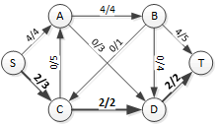
Edmonds-Karp 4
Find shortest path in residual graph
After this, flow = 6, so we are done.

Slide 9
Crude Analysis: Edmonds-Karp Algorithm
Edmonds-Karp algorithm does at most O(VE) augmentations
Each augmentation causes one edge to “disappear” from the residual network.
It can only be put back on a longer path.
Since the paths must be simple paths, for each edge there are O(V) possible longer paths.
So each edge can be augmented at most O(V) times
And there are E=O(E) edges.
The while loop in Ford-Fulkerson takes O(E) time
So Edmonds-Karp runs in time O(VE²)

Slide 10
Finding the Minimum Cut Edges
Can find the value of the minimum cut from running the Ford Fulkerson method.
To find the actual edges in this cut:
Take the final residual graph G_{f} . Since there are no more augmenting paths, some edges will have value 0 in G_{f}.
Identify all the vertices v_{s} reachable from source s in G_{f}.
For each vertex in v_{s}, find all edges in the original graph G that go from v_{s} to vertices that are not reachable in G_{f}.
The set of all such edges form the minimum cut.

Slide 11
Bipartite Matching
Suppose you have two sets of nodes, call them Type 1 and Type 2. Suppose that every edge in the graph goes between a Type 1 node and a Type 2 node.
What is the maximum number of type 1-type 2 pairs that we can create?
This is called the bipartite matching problem. If you have equal numbers of each type, and you can find a matching that uses them all, you have a perfect matching.

Slide 12
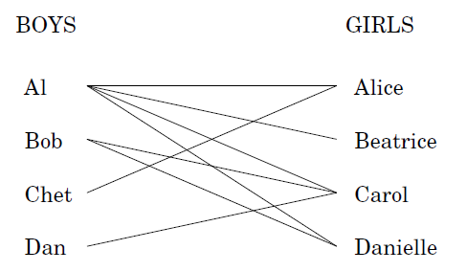
Pictorial
Suppose you’re a high school tennis coach and you’re trying to see how many mixed-doubles teams you can field.
Everybody has listed who they are willing to play with.

Slide 13
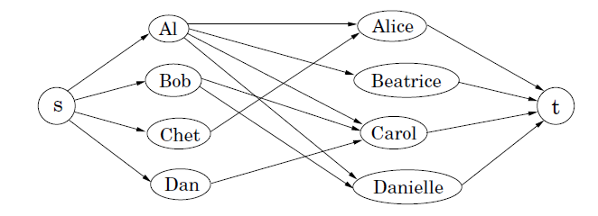
Bipartite Matching as Network Flow
Treat this as a network flow problem, with a source attached to each boy and a sink attached to each girl (or conversely), and a capacity of one on each edge.
A maximal bipartite matching corresponds to a maximal network flow.

Slide 14
Tripartite Matching I
Now let’s take it one step further.
Suppose you have lists of:
Courses you need to take
Locations you are willing to take them
Nights they are offered
Could you use a network flow algorithm to find the maximum number of courses you could take meeting some criteria?

Slide 15
Tripartite Matching II - example
Suppose you are willing to take courses at St. Paul, Midway, or Normandale (not Minneapolis or Brooklyn Park)
Suppose you are free Monday, Tuesday, and Wednesday
Suppose you need ICS 365, 372, 440, 460, 462

Slide 16
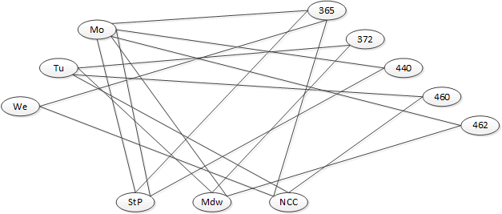
Tripartite Matching III - example

Slide 17
Tripartite Matching IV
Unfortunately, this doesn’t yield to network flow algorithms.
It’s a type of problem called “NP-Complete”.
The only known way to find the optimal solution (maximum number of courses) is to try everything.
We will discuss NP-Completeness next.

